Slide 1



ARCHITECTURE OF ELECTRONIC COMPUTING MACHINE & COMPUTING SYSTEMS
Prepared & Presented by: Mirlan Nurbekov, Lecturer
Office hours: Friday 9:00–17:00
AlaToo IT & Business College
Fall 2025

Slide 2


Slide 3
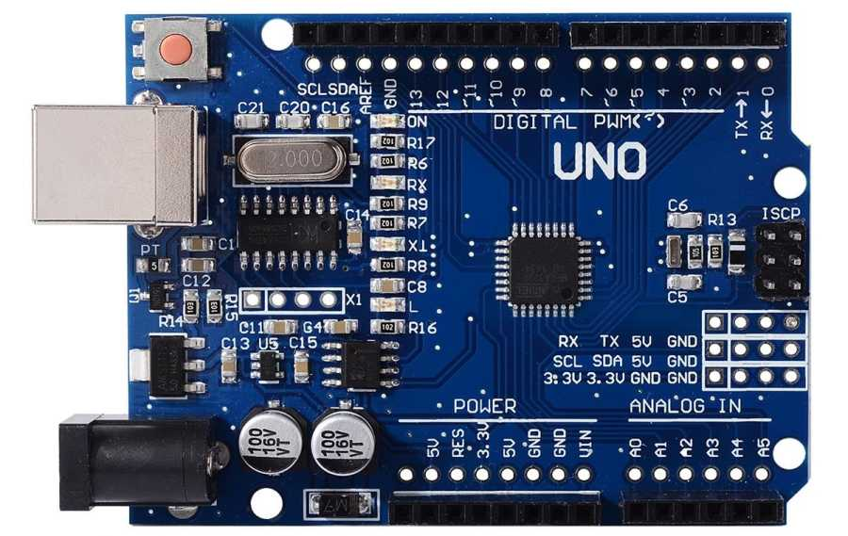
Arduino UNO smd

Slide 4
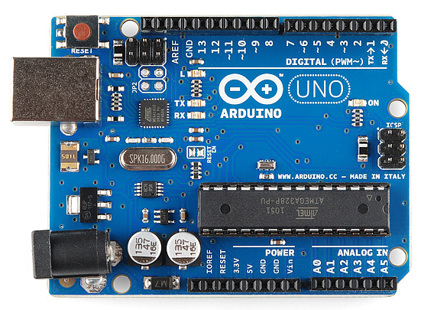
Arduino UNO

Slide 5
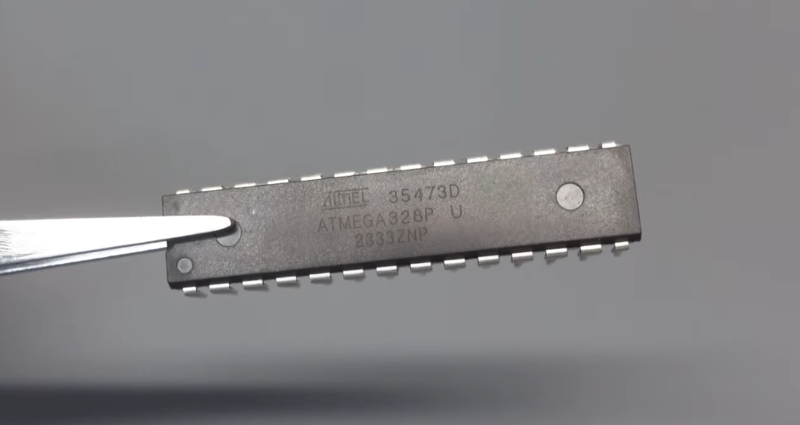
ATmega328P
8-bit Processor
32Kb Memory
16MHz Clock Speed

Slide 6
Why do we choose Arduino Uno?
Arduino Uno uses the ATmega328P microcontroller because it offers the right balance of performance, low power consumption, and cost. It has enough memory and I/O pins for most beginner and intermediate projects, is widely supported by open-source tools, and is reliable for both learning and prototyping.

Slide 7
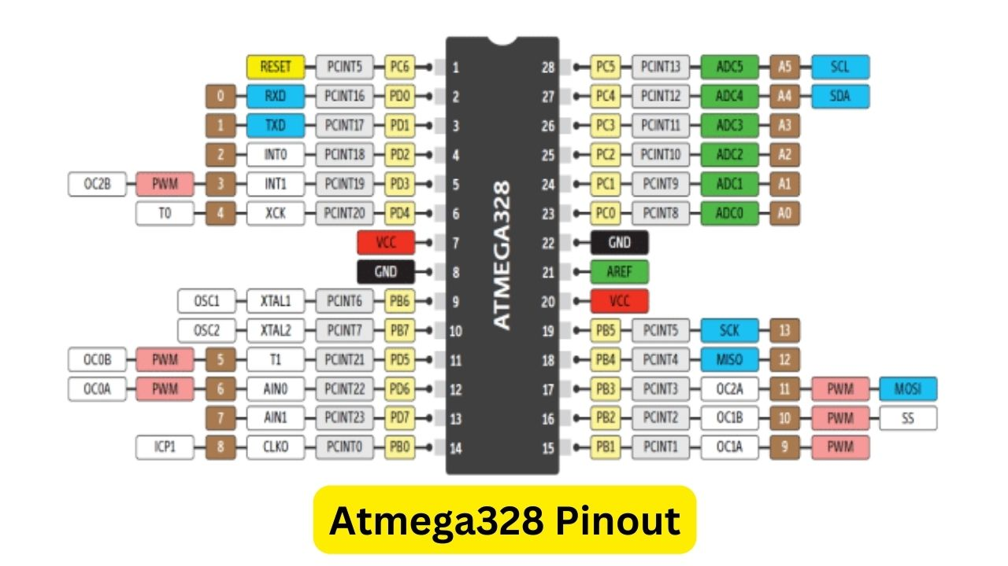

Slide 8
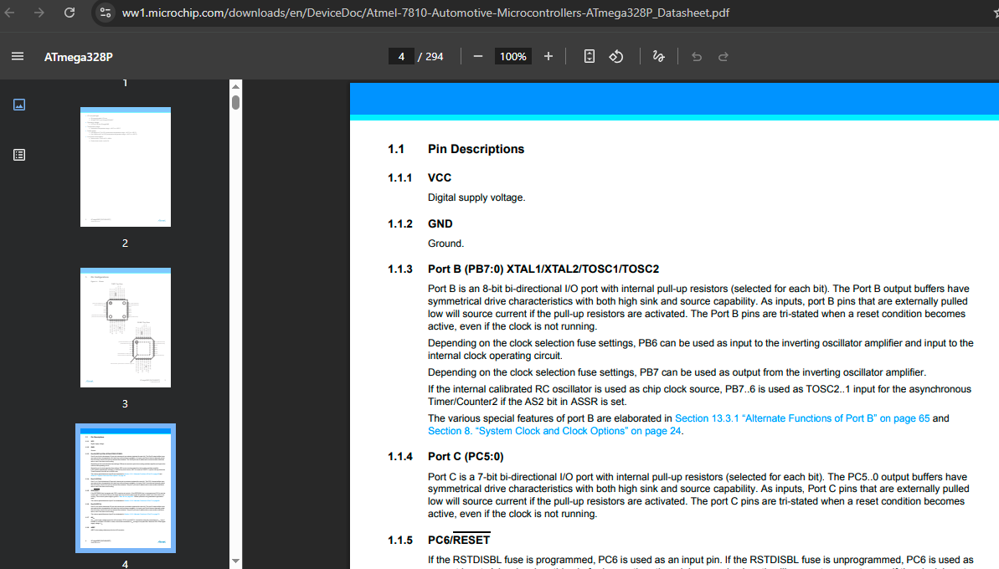

Slide 9
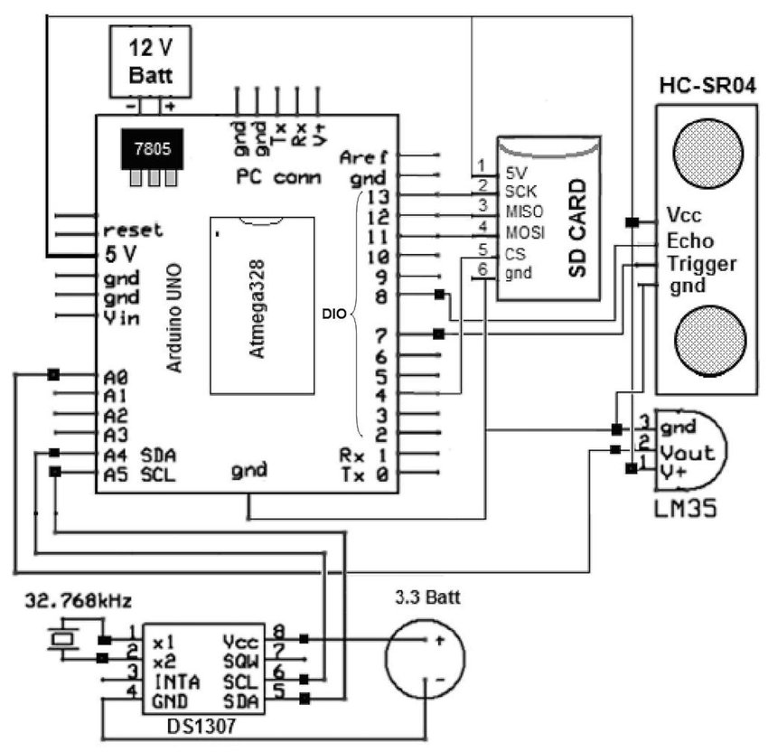

Slide 10
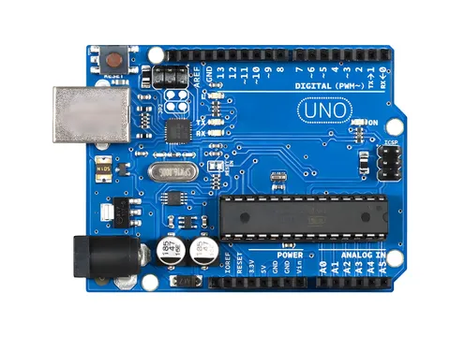
USB PORT
USB-serial converter (UART serial) - TX/RX

Slide 11
USB port - is used for two main purposes: to program the microcontroller by uploading code from a computer, and to provide power to the board. It also allows serial communication for debugging and data exchange with the PC.
USB-serial converter (UART serial) - TX/RX The ATmega328P works with UART serial (TX/RX pins), not USB directly. The converter translates between USB signals from the computer and UART signals the microcontroller understands. UART stands for Universal Asynchronous Receiver-Transmitter. It is a hardware communication protocol that sends and receives data serially using TX (transmit) and RX (receive) lines.

Slide 12
Polyfuse
Voltage regulator

Slide 13
A polyfuse is a resettable fuse that protects the Arduino from overcurrent. If too much current flows, it temporarily disconnects power, then resets itself when the fault is cleared.
The voltage regulator ensures the Arduino always receives a stable 5V supply. It protects the board by converting higher input voltages (like 7–12V) down to safe operating levels.

Slide 14
RESET BTN
LED
DC Barrel Jack

Slide 15
The DC barrel jack allows the Arduino to be powered from an external adapter (7–12V). The onboard voltage regulator then converts this input to a safe 5V for the board.
The RESET button restarts the Arduino by resetting the microcontroller. It stops the current program and runs the uploaded code again from the beginning.
The built-in LED (usually on pin 13) is used as a simple indicator. It helps test code, debug programs, and confirm that the Arduino is running.

Slide 16
DIGITAL I/O PINS

Slide 17
~Tilde

Slide 18
Digital I/O pins can be configured as either input or output. They read digital signals (HIGH/LOW) from sensors or switches, and control devices like LEDs, motors, and relays.
Pins marked with ‘~’ support PWM (Pulse Width Modulation). PWM lets the Arduino simulate analog output, for example to dim LEDs or control motor speed.

Slide 19
Power

Slide 20
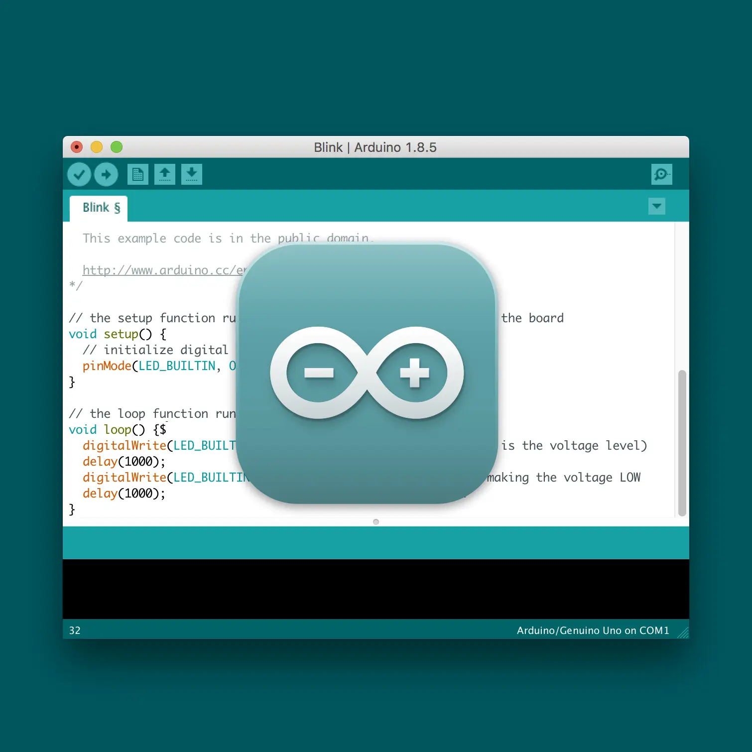
Arduino IDE
(Integrated Development Environment)

Slide 21
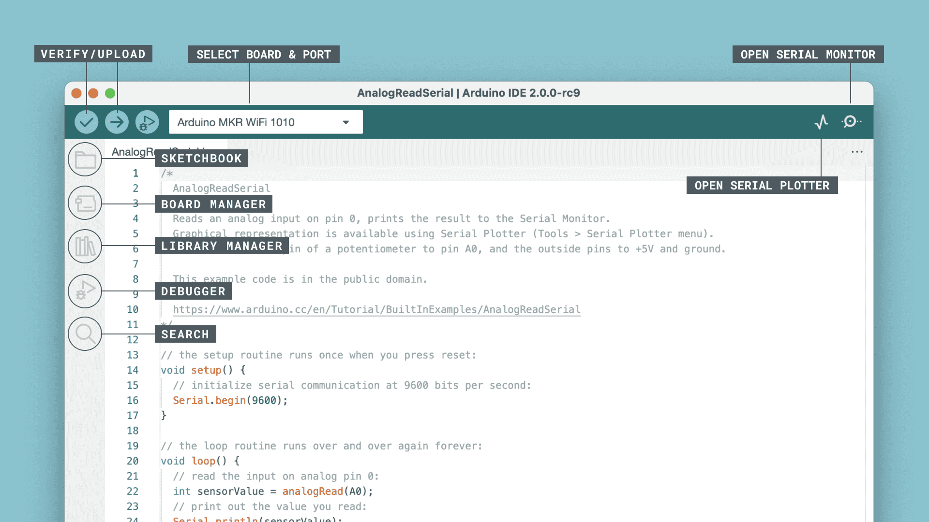
Arduino IDE

Slide 22
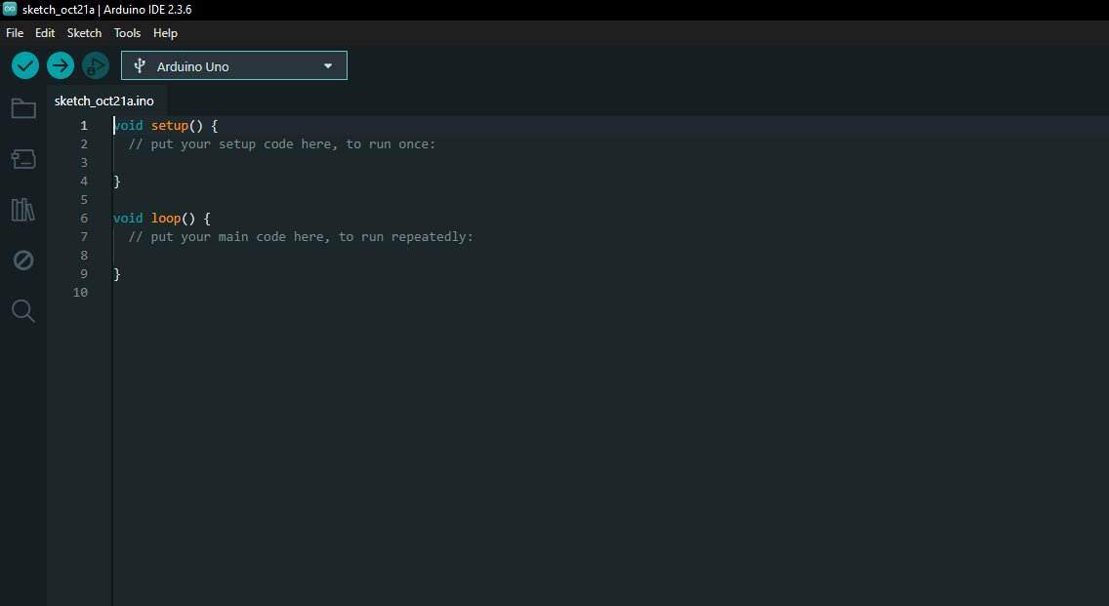
Arduino IDE

Slide 23
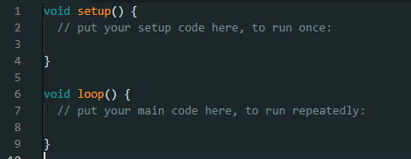
Arduino IDE

Slide 24

Simulation options

Slide 25

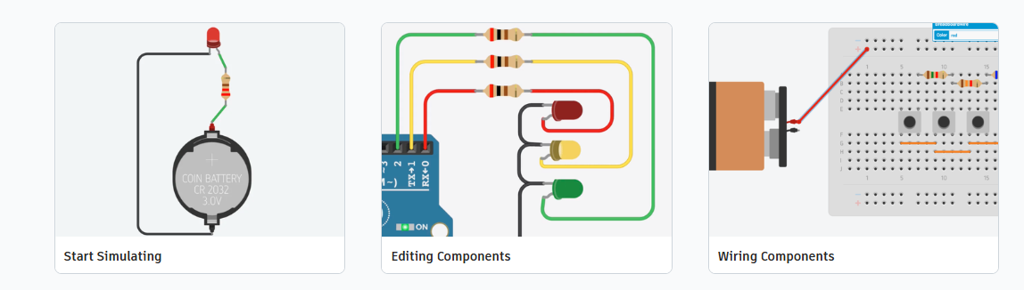
https://www.tinkercad.com/circuits

Slide 26
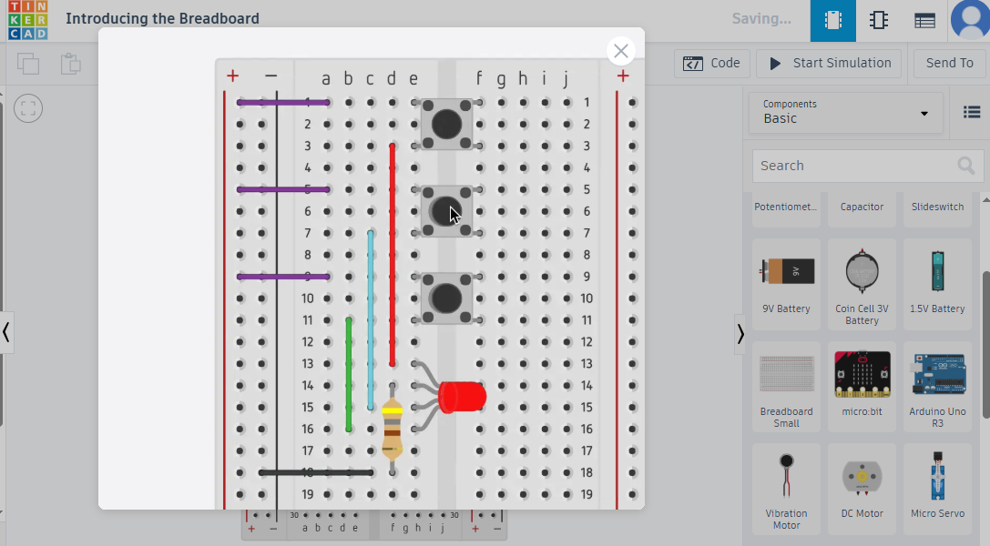

Slide 27
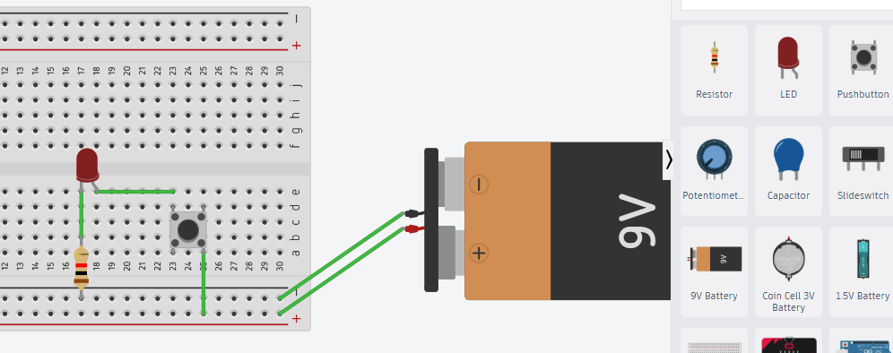
Simulations using TinkerCad

Slide 28

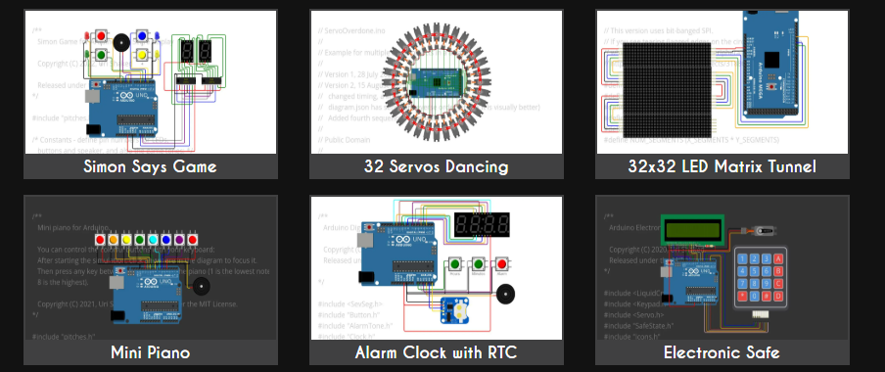
https://wokwi.com/

Slide 29
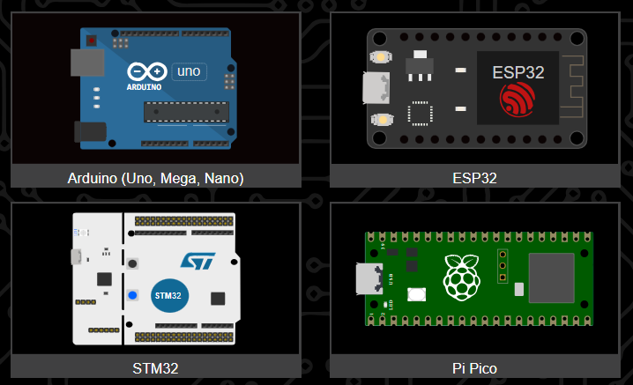

Slide 30
